Slide 1
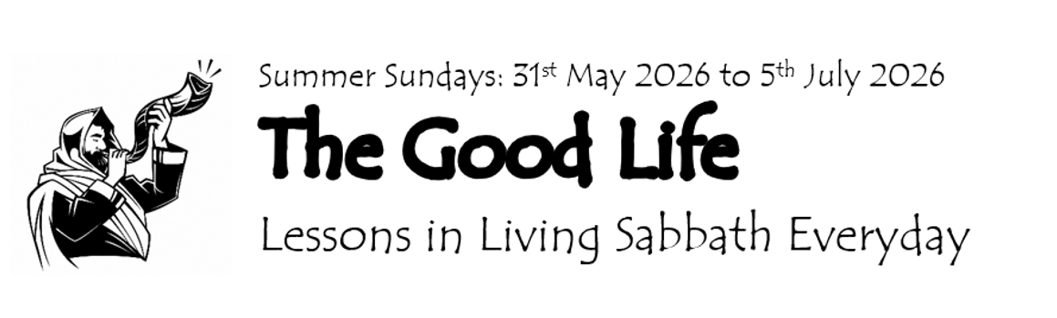
Welcome to St Barnabas today!
Sunday 7th June 2026

Slide 2
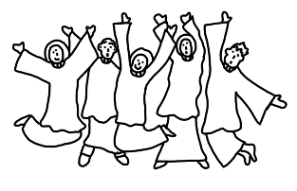
Gathering for worship
Grace, mercy and peace
from God our Father
and the Lord Jesus Christ
be with you
and also with you

Slide 3
Gathering for worship
Almighty God,
to whom all hearts are open,
all desires known
and from whom
no secrets are hidden,

Slide 4
cleanse the thoughts of our hearts by the inspiration of
your Holy Spirit that
we may perfectly love you
and worthily magnify
your holy name, through Christ our Lord. Amen

Slide 5

Gathering for worship
Our opening hymn is
Lord of all hopefulness
A&M 719

Slide 6
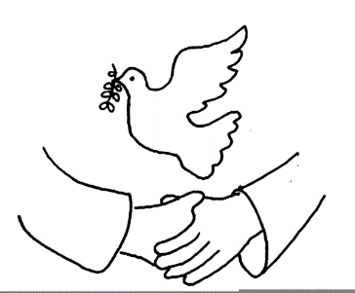
Lord of all hopefulness,
Lord of all joy,
whose trust, ever childlike,
no cares could destroy,
be there at our waking,
and give us, we pray,
your bliss in our hearts,
Lord, at the break of the day.

Slide 7
Lord of all eagerness,
Lord of all faith,
whose strong hands were skilled
at the plane and the lathe,
be there at our labours,
and give us, we pray,
your strength in our hearts,
Lord, at the noon of the day.

Slide 8
Lord of all kindliness,
Lord of all grace,
your hands swift to welcome,
your arms to embrace,
be there at our homing,
and give us, we pray,
your love in our hearts,
Lord, at the eve of the day.

Slide 9
Lord of all gentleness,
Lord of all calm,
whose voice is contentment,
whose presence is balm,
be there at our sleeping,
and give us, we pray,
your peace in our hearts,
Lord, at the end of the day.

Slide 10
Lord of all hopefulness,
Lord of all joy,
whose trust, ever childlike,
no cares could destroy,
be there at our waking,
and give us, we pray,
your bliss in our hearts,
Lord, at the break of the day.

Slide 11
Lord of all eagerness,
Lord of all faith,
whose strong hands were skilled
at the plane and the lathe,
be there at our labours,
and give us, we pray,
your strength in our hearts,
Lord, at the noon of the day.

Slide 12
Lord of all kindliness,
Lord of all grace,
your hands swift to welcome,
your arms to embrace,
be there at our homing,
and give us, we pray,
your love in our hearts,
Lord, at the eve of the day.

Slide 13

Preparing our Hearts
Our first reading
Isaiah 58:6-14

Slide 14
Preparing our Hearts
Is not this the fast that I choose:
to loose the bonds of injustice,
to undo the thongs of the yoke,
to let the oppressed go free
and to break every yoke?
Is it not to share your bread with the hungry
and bring the homeless poor into your house;
when you see the naked, to cover them,
and not to hide yourself from your own kin?

Slide 15
Then our light
shall break forth
like the dawn,
and our healing
shall spring up quickly;
our vindicator shall go before us,
the glory of the Lord
shall be our rearguard.

Slide 16
Then we shall call,
and the Lord will answer;
we shall cry for help,
and he will say,
Here I am.

Slide 17
If you remove the yoke from among you,
the pointing of the finger, the speaking of evil,
if you offer your food to the hungry
and satisfy the needs of the afflicted,
then your light shall rise in the darkness
and your gloom be like the noonday.
The Lord will guide you continually,
and satisfy your needs in parched places,
and make your bones strong;

Slide 18
And we shall be like a watered garden,
like a spring of water,
whose waters never fail.
Our ancient ruins shall be rebuilt;
we shall raise up
the foundations of many generations;
we shall be called
the repairer of the breach,
the restorer of streets to live in.

Slide 19
If you refrain from trampling the sabbath,
from pursuing your own interests
on my holy day;
if you call the sabbath a delight
and the holy day of the Lord honourable;
if you honour it, not going your own ways,
serving your own interests,
or pursuing your own affairs;
then you shall take delight in the Lord.

Slide 20
and he will make us ride
upon the heights of the earth;
he will feed us
with the heritage of our ancestor Jacob
for the mouth of the Lord has spoken.

Slide 21
Let us acknowledge our many failures
to keep this way of truth and life
A time of silence for reflection

Slide 22
Celebrating God’s Presence
May the Father of all mercies cleanse us from our sins, and restore us in his image to the praise and glory of his name, through Jesus Christ our Lord.
Amen.

Slide 23
Celebrating God’s Presence
The Collect, the family prayer for the week
God of truth,
help us to keep your law of love
and to walk in ways of wisdom,
that we may find true life
in Jesus Christ your Son.
Amen.

Slide 24
Celebrating God’s Presence
Our Gospel hymn is
Give thanks
with a grateful heart
Tune A&M 639

Slide 25
Verse
Give thanks with a grateful heart,
give thanks to the Holy One;
give thanks because he’s given
Jesus Christ, his Son.
repeat

Slide 26
Chorus
And now let the weak say,
‘I am strong!’
Let the poor say, ‘I am rich
because of what the Lord
has done for us!’
repeat

Slide 27
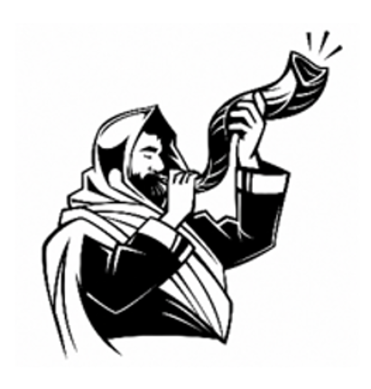
Hear the Gospel
of our Lord Jesus Christ
according to Matthew
Glory to you O Lord
Matthew 9:9–13, 18–26
This is the Gospel of the Lord
Praise to you O Christ

Slide 28
Today’s Reflection
Sabbath is
a good meal

Slide 29

Responding in Faith
Let us declare our faith in God.
We believe in God the Father,
from whom every family in heaven and on earth is named.

Slide 30
Responding in Faith
We believe in God the Son,
who lives in our hearts through faith, and fills us with his love.

Slide 31
Responding in Faith
We believe in God the Holy Spirit,
who strengthens us with power from on high.
We believe in one God;
Father, Son and Holy Spirit.
Amen.

Slide 32
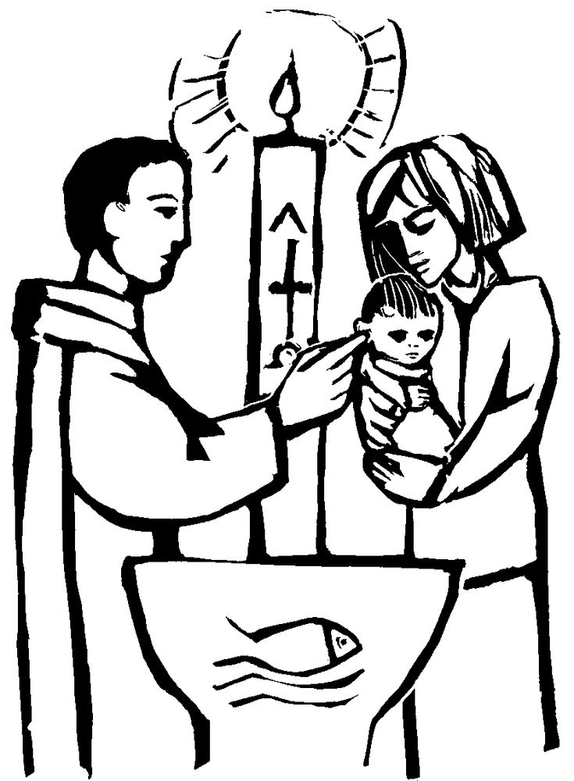
Welcoming Ellie and Alaya

Slide 33
Responding in Faith
Today’s Intercessions

Slide 34
Responding in Faith
Sabbath-rest is promised for the people of God; for anyone who enters God’s rest also rests from their works, just as God did from his, and Christ Jesus is Lord of the sabbath.
The peace of the Lord be always with you.
And also with you.

Slide 35
Responding in Faith
Our hymn of preparation is
Brother, sister let me serve you
A&M 604

Slide 36
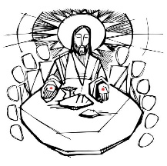
Brother, sister, let me serve you,
let me be as Christ to you;
pray that I may have the grace
to let you be my servant too.
We are pilgrims on a journey,
and companions on the road;
we are here to help each other
walk the mile and bear the load.

Slide 37
I will hold the Christ-light for you
in the night-time of your fear;
I will hold my hand out to you,
speak the peace you long to hear.
I will weep when you are weeping;
when you laugh, I'll laugh with you;
I will share your joy and sorrow
till we've seen this journey through.

Slide 38
When we sing to God in heaven,
we shall find such harmony,
born of all we've known together
of Christ's love and agony.
Brother, sister, let me serve you,
let me be as Christ to you;
pray that I may have the grace to
let you be my servant too.

Slide 39
Prayers at the Table
With this bread that we bring we shall remember Jesus. With this wine that we bring we shall remember Jesus. Gifts from God to his table we bring

Slide 40
Prayers at the Table
The Lord of the Sabbath is here God’s Spirit is with us. Lift up your hearts We lift them to the Lord. Let us give thanks to the Lord our God It is right to give thanks and praise.

Slide 41
Prayers at the Table
It is right at all times and in all seasons to give you thanks and praise. Through Moses and the prophets you taught your people to remember the sabbath and to delight in your goodness.

Slide 42
Prayers at the Table
In your Son Jesus Christ you revealed the true purpose of the sabbath: to bring freedom to the burdened, healing to the broken, welcome to the outsider, and rest to the weary.

Slide 43
Prayers at the Table
And now, at his table, you gather us as one family, feed us with the bread of life, and give us a foretaste of the eternal sabbath of your kingdom.

Slide 44
Prayers at the Table
Therefore with angels and archangels and with all the company of heaven,
we proclaim your great and glorious name for ever praising you and singing:

Slide 45
Prayers at the Table
Holy, holy, holy, holy,
Lord of power, Lord of might.
Heav’n and earth
are full of your glory.
Sing hosanna evermore.

Slide 46
Prayers at the Table
Blest and holy, blest and holy
he who comes from God on high.
Raise your voices, sing his glory,
praise his name for evermore.

Slide 47
Prayers at the Table
Accept our praises, heavenly Father, through your Son our Saviour Jesus Christ, and as we follow his example and obey his command, grant that by the power of your Holy Spirit these gifts of bread and wine may be to us his body and his blood;

Slide 48
Prayers at the Table
who in the same night that he was betrayed, took bread and gave you thanks; he broke it and gave it to his disciples, saying: Take, eat; this is my body which is given for you; do this in remembrance of me.

Slide 49
Prayers at the Table
In the same way, after supper he took the cup and gave you thanks; he gave it to them, saying: Drink this, all of you; this is my blood of the new covenant, which is shed for you and for many for the forgiveness of sins. Do this, as often as you drink it, in remembrance of me.

Slide 50
Prayers at the Table
Great is the mystery of faith
Christ has died
Christ is risen
Christ will come again

Slide 51
Prayers at the Table
Therefore, heavenly Father, we remember now his offering of himself made once for all upon the cross; we proclaim his mighty resurrection and glorious ascension; and as we look for the coming of your kingdom, we make with this bread and this cup the memorial of Christ your Son our Lord.

Slide 52
Prayers at the Table
Accept through him, our great high priest, this our sacrifice of thanks and praise, and as we eat and drink these holy gifts in the presence of your divine majesty, renew us by your Holy Spirit, inspire us with your love and unite us in the body of your Son, Jesus Christ our Lord.

Slide 53
Prayers at the Table
Through him, and with him, and in him, in the unity of the Holy Spirit, with all who stand before you in earth and heaven, we worship you, Father almighty, in songs of everlasting praise:
Blessing and honour and glory
and power be yours for ever and ever.
Amen!

Slide 54
Prayers at the Table
We say the Lord’s Prayer together and then we pray:
Holy God, holy and strong, holy and immortal
give us the bread
of everlasting life
and make us branches
of the true vine. Amen

Slide 55
Prayers at the Table
People of God, people of life: we gather as a holy communion, for a meal that has been shared countless times, in countless places and in countless ways. The first time this meal was shared, Jesus promised that whenever the bread was broken and the wine poured, wherever the story was told around a table, he would be there.

Slide 56
Today as we remember the story, as it’s been told a thousand times over, we eat the bread, and we drink the wine; and we affirm that we all belong at this table, and that Jesus is here.
This is a holy table, with
food to fill a hungry world and
wine to quench our thirsty hearts. Amen

Slide 57
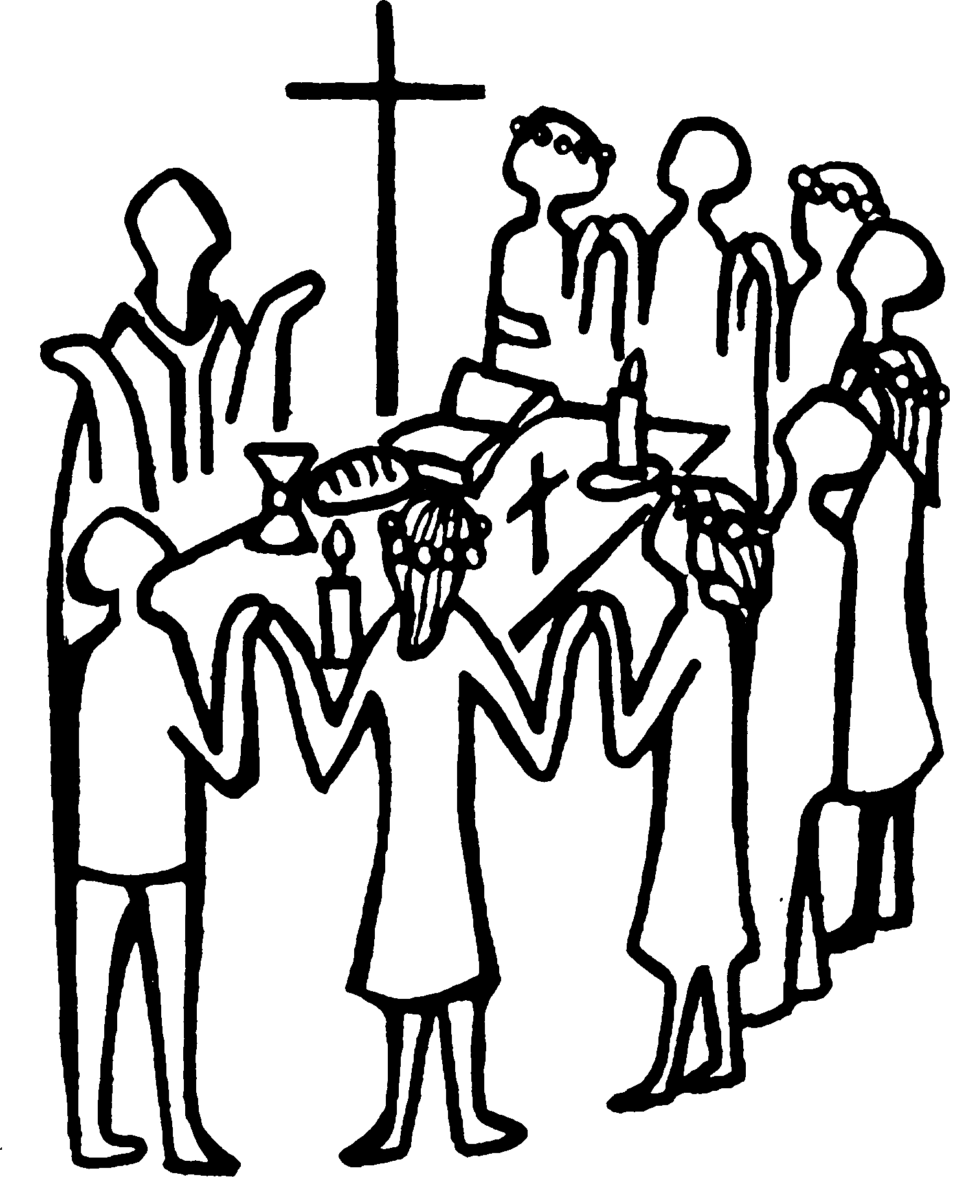
As communion is shared,
we sing
Holy, Holy
A&M 417

Slide 58
Holy, holy
Holy is the Lord God Almighty
Who was, and is, and is to come
Who was, and is, and is to come
Lift up His name with the sound of singing
Lift up His name in all the earth
Lift up your voice and give Him glory
For He is worthy to be praised

Slide 59
Thanksgiving and Farewell
Almighty God, we thank you for feeding us
with the body and blood of your Son Jesus Christ. Through him we offer you our souls and bodies to be a living sacrifice. Send us out in the power of your Spirit to live and work to your praise and glory. Amen.
Notes:
Welcome screen

Slide 60
Thanksgiving and Farewell
Our farewell hymn is
When I needed a neighbour
A&M 575
Notes:
Welcome screen

Slide 61
When I needed a neighbour,
were you there, were you there?
When I needed a neighbour,
were you there?
And the creed and the colour
and the name won't matter,
were you there?

Slide 62
I was hungry and thirsty,
were you there, were you there?
I was hungry and thirsty,
were you there?
And the creed and the colour
and the name won't matter,
were you there?

Slide 63
I was cold, I was naked,
were you there, were you there?
I was cold, I was naked,
were you there?
And the creed and the colour
and the name won't matter,
were you there?

Slide 64
When I needed a shelter,
were you there, were you there?
When I needed a shelter,
were you there?
And the creed and the colour
and the name won't matter,
were you there?

Slide 65
When I needed a healer,
were you there, were you there?
When I needed a healer,
were you there?
And the creed and the colour
and the name won't matter,
were you there?

Slide 66
Wherever you travel,
I’ll be there, I’ll be there!
Wherever you travel,
I’ll be there!
And the creed and the colour
and the name won't matter,
I’ll be there!

Slide 67
Thanksgiving and Farewell
Notices are shared
Notes:
Welcome screen

Slide 68
Thanksgiving and Farewell
God of eternity
teach us to pause.
God of creation
teach us to wonder.
God of Sabbath
teach us to rest.
God of delight
teach us to play.
Notes:
Welcome screen

Slide 69
Thanksgiving and Farewell
God of the poor
teach us to share
in your work of liberation.
God of love
fill our lives with
your perfect peace. Amen.
Notes:
Welcome screen

Slide 70
The blessing of God,
Creator, Redeemer and Sustainer,
shape you, restore you and uphold you
now and forever.
Amen.
Go in peace to love and serve the Lord.
In the name of Christ. Amen.
Notes:
Welcome screen

