Slide 1

Welcome to our service today
St Barnabas Church 3-May-26

Slide 2
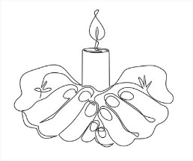
Gathering for Worship
We light our Easter candle

Slide 3
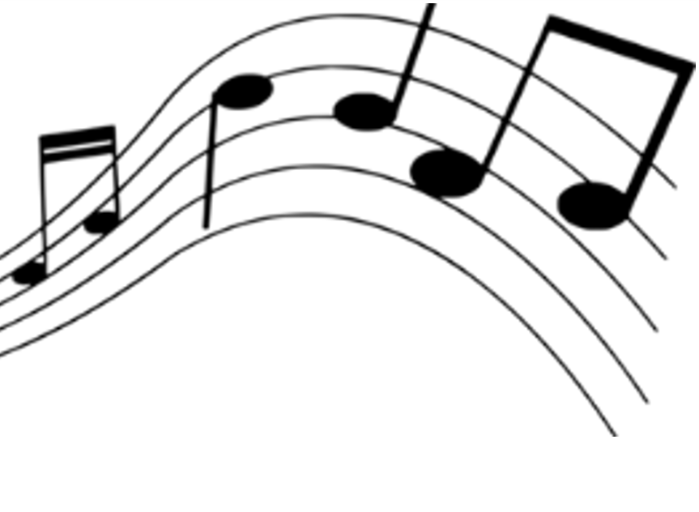
Gathering for Worship
Grace, mercy and peace from God our Father and the Lord Jesus Christ be with you
and also with you.

Slide 4
Gathering for Worship
Almighty God, to whom all hearts are open, all desires known and from whom no secrets are hidden

Slide 5
Gathering for Worship
cleanse the thoughts of our hearts by the inspiration of your Holy Spirit

Slide 6
Gathering for Worship
that we may perfectly love you and worthily magnify your holy name, through Christ our Lord. Amen.

Slide 7
Gathering for Worship
Our opening hymn is
All glory, laud and honour
A&M 159 vv 1-5

Slide 8
All glory, laud and honour
to thee, Redeemer King,
to whom the lips of children
made sweet hosannas ring.
Thou art the King of Israel,
thou David’s royal Son,
who in the Lord’s name comest,
the King and blessed One.

Slide 9
All glory, laud and honour
to thee, Redeemer King,
to whom the lips of children
made sweet hosannas ring.
The company of angels
are praising thee on high,
and mortal men and all things
created make reply.

Slide 10
All glory, laud and honour
to thee, Redeemer King,
to whom the lips of children
made sweet hosannas ring.
The people of the Hebrews
with palms before thee went;
our praise and prayer and
anthems before thee we present.

Slide 11
All glory, laud and honour
to thee, Redeemer King,
to whom the lips of children
made sweet hosannas ring.
To thee before thy passion
they sang their hymns of praise;
to thee, now high exalted,
our melody we raise.

Slide 12
All glory, laud and honour
to thee, Redeemer King,
to whom the lips of children
made sweet hosannas ring.
Thou didst accept their praises,
accept the prayers we bring,
who in all good delightest,
thou good and gracious King.

Slide 13
All glory, laud and honour
to thee, Redeemer King,
to whom the lips of children
made sweet hosannas ring.

Slide 14
Preparing our Hearts
Coming together as God’s family, with confidence let us ask for wholeness from the Lord, for he is full of gentleness and compassion.
A time of silence for reflection

Slide 15
Preparing our Hearts
Almighty God,
our heavenly Father,
we have sinned against you
and against our neighbour
in thought and word and deed,

Slide 16
Preparing our Hearts
through negligence,
through weakness,
through our own deliberate fault.
We are truly sorry
and repent of all our sins.

Slide 17
Preparing our Hearts
For the sake of your Son
Jesus Christ, who died for us,
forgive us all that is past,
and grant that we may serve you
in newness of life to the glory
of your name. Amen

Slide 18
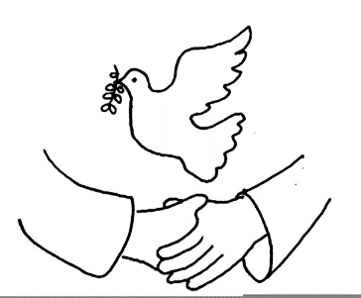
Celebrating God’s Presence
May the Father restore you by his
Spirit and raise you to new life in
Christ our Lord.
Amen.

Slide 19
Celebrating God’s Presence
Our gospel hymn is
The Clapping Gloria

Slide 20
Gloria 👏👏
Gloria 👏👏
in excelsis deo!
repeat

Slide 21
Lord God heavenly King
Peace You bring to us
We worship You
We give You thanks
We sing our song of praise

Slide 22
Gloria 👏👏
Gloria 👏👏
in excelsis deo!
repeat

Slide 23
Jesus Saviour of all
Lord God Lamb of God
You take away our sins
Oh Lord have mercy on us all

Slide 24
Gloria 👏👏
Gloria 👏👏
in excelsis deo!
repeat

Slide 25
At the Father's right hand
Lord receive our prayer
For You alone are the Holy One
And You alone are God

Slide 26
Gloria 👏👏
Gloria 👏👏
in excelsis deo!
repeat

Slide 27
Glory Father and Son
Glory holy Spirit
To You we raise our hands up high
We glorify Your name

Slide 28
Gloria 👏👏
Gloria 👏👏
in excelsis deo!
repeat

Slide 29
Celebrating God’s Presence
The Collect, the family prayer for the week
Risen Christ, your wounds declare your love for the world and the wonder of your risen life: give us compassion and courage
to risk ourselves for those we serve,
to the glory of God the Father.
Amen.

Slide 30
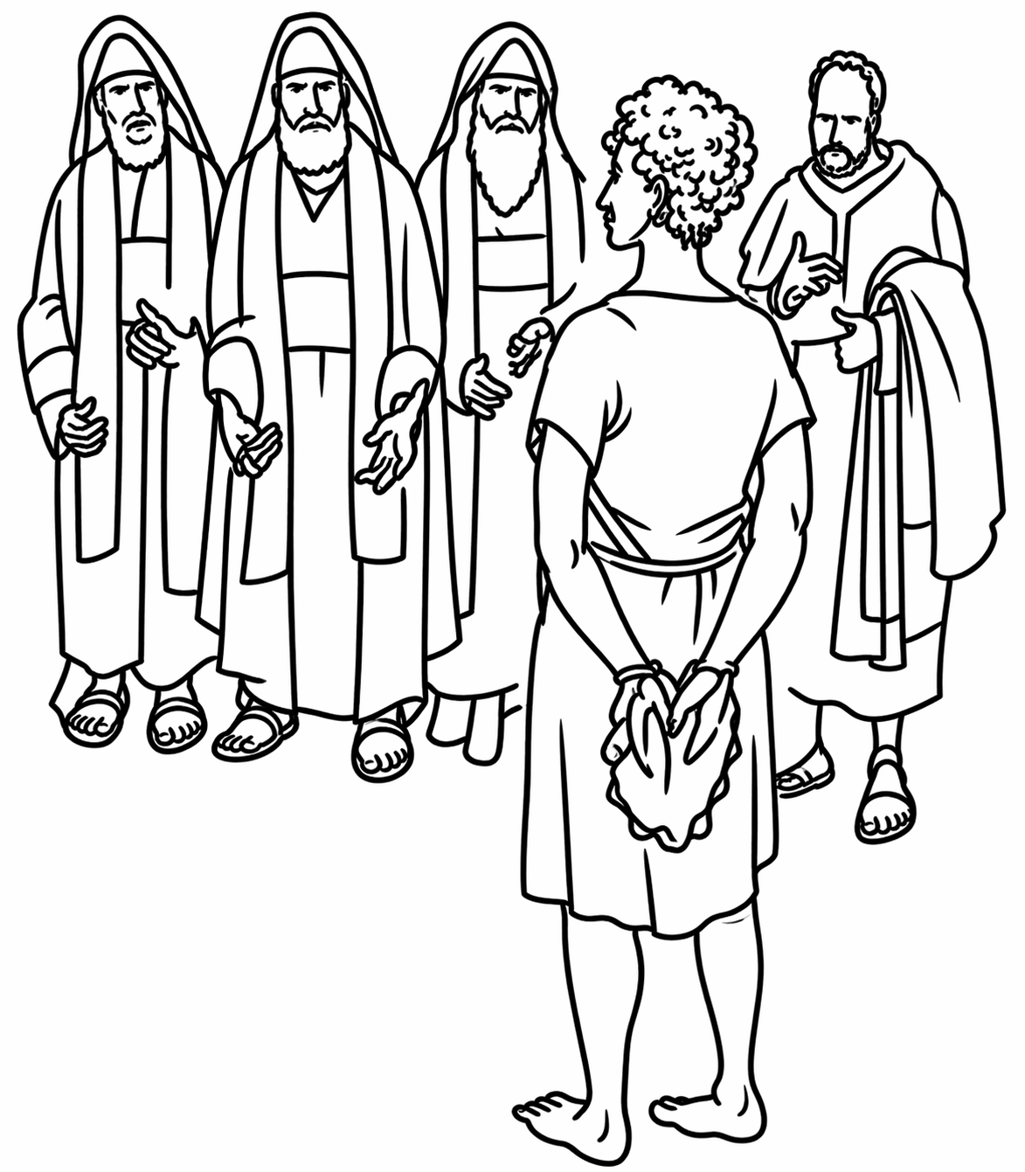
Today’s Readings
Our first reading is
Acts 7:55-60
In which we meet Stephen

Slide 31

Today’s Readings
Hear the Gospel of our Lord Jesus Christ according to John
Glory to you O Lord
John 14:1-14
This is the Gospel of the Lord
Praise to you O Christ

Slide 32

The Easter Threshold

Slide 33

Responding in Faith
Do you believe and trust in God the Father, source of all being and life, the one for whom we exist?
We believe and trust in Him

Slide 34
Responding in Faith
Do you believe and trust in God the Son, who took our human nature, died for us and rose again?
We believe and trust in Him

Slide 35
Responding in Faith
Do you believe and trust in God the Holy Spirit, who gives life to the people of God and makes Christ known in the world?
We believe and trust in Him

Slide 36
Responding in Faith
This is the faith of the Church.
This is our faith.
We believe and trust
in one God, Father, Son
and Holy Spirit. Amen.

Slide 37
Responding in Faith
Today’s Intercessions

Slide 38
Responding in Faith
Christ came and proclaimed the gospel, peace to those who are far off and peace to those who are near.
The peace of the Lord
be always with you
And also with you

Slide 39
Responding in Faith
Our hymn of preparation is
O Jesus I have promised
A&M 748 vv 1,3,4

Slide 40
O Jesus, I have promised
to serve you to the end;
be thou for ever near me,
my Master and my Friend:
I shall not fear the battle
if thou art by my side,
nor wander from the pathway
if thou wilt be my guide.

Slide 41
O let me hear thee speaking
in accents clear and still;
above the storms of passion,
the murmurs of self-will;
O speak to reassure me,
to hasten or control;
O speak and make me listen,
thou guardian of my soul.

Slide 42
O Jesus, thou hast promised,
to all who follow thee,
that where thou art in glory
there shall thy servant be;
and, Jesus, I have promised
to serve thee to the end:
O give me grace to follow,
my Master and my friend.

Slide 43
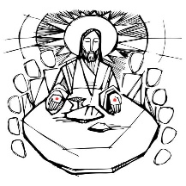
Prayers at the Table
Be present, be present,
Lord Jesus Christ,
our risen high priest;
and make yourself known
in the breaking of bread.
Amen.

Slide 44
Prayers at the Table
The Lord is here
God’s Spirit is with us.
Lift up your hearts.
We lift them to the Lord.
Let us give thanks to the Lord our God.
It is right to give thanks and praise.

Slide 45
Prayers at the Table
It is indeed right, our duty and our joy, always and everywhere to give you thanks, almighty and eternal Father, and in these days of Easter to celebrate with joyful hearts the memory of your wonderful works.

Slide 46
Prayers at the Table
For by the mystery of his passion Jesus Christ, your risen Son, has conquered the powers of death and hell and restored in men and women the image of your glory. He has placed them once more in paradise and opened to them the gates of life eternal.

Slide 47
Prayers at the Table
And so, in the joy of this Passover, earth and heaven resound with gladness, while angels and archangels and the powers of all creation sing for ever the hymn of your glory:

Slide 48
Prayers at the Table
Holy, holy, holy, holy,
Lord of power, Lord of might.
Heav’n and earth
are full of your glory.
Sing hosanna evermore.

Slide 49
Prayers at the Table
Blest and holy, blest and holy
he who comes from God on high.
Raise your voices, sing his glory,
praise his name for evermore.

Slide 50
Prayers at the Table
We praise and bless you, loving Father, through Jesus Christ, our Lord; and as we obey his command, send your Holy Spirit, that broken bread and wine outpoured may be for us the body and blood of your dear Son.

Slide 51
Prayers at the Table
On the night before he died he had supper with his friends and, taking bread, he praised you. He broke the bread, gave it to them and said: Take, eat; this is my body which is given for you; do this in remembrance of me.

Slide 52
Prayers at the Table
When supper was ended he took the cup of wine. Again he praised you, gave it to them and said: Drink this, all of you; this is my blood of the new covenant, which is shed for you and for many for the forgiveness of sins. Do this, as often as you drink it,
in remembrance of me.

Slide 53
Prayers at the Table
So, Father, we remember all that Jesus did, in him we plead with confidence his sacrifice made once for all upon the cross. Bringing before you the bread of life and cup of salvation, we proclaim his death and resurrection until he comes in glory.

Slide 54
Prayers at the Table
Jesus Christ is Lord!
Lord, by your cross and resurrection you have set us free.
You are the Saviour of the World.

Slide 55
Prayers at the Table
Lord of all life, help us to work together for that day when your kingdom comes and justice and mercy will be seen in all the earth. Look with favour on your people, gather us in your loving arms and bring us with all the saints to feast at your table
in heaven.

Slide 56
Prayers at the Table
Through Christ, and with Christ, and in Christ, in the unity of the Holy Spirit, all honour and glory are yours, O loving Father, for ever and ever.
Amen!

Slide 57
Prayers at the Table
We say the Lord’s Prayer together and then we pray
We break the bread of life,
and that life is the light of the world.
God here among us,
light in the midst of us,
bring us to light and life.

Slide 58
Prayers at the Table
This is Christ’s table.
He welcomes all. Come and be fed.
Voices old and new,
Lives young and old.
This is who we are.
This is who we are becoming.
Amen! Together we come!

Slide 59
Thanksgivings
Communion is shared and we sing
The servant king
A&M 489

Slide 60
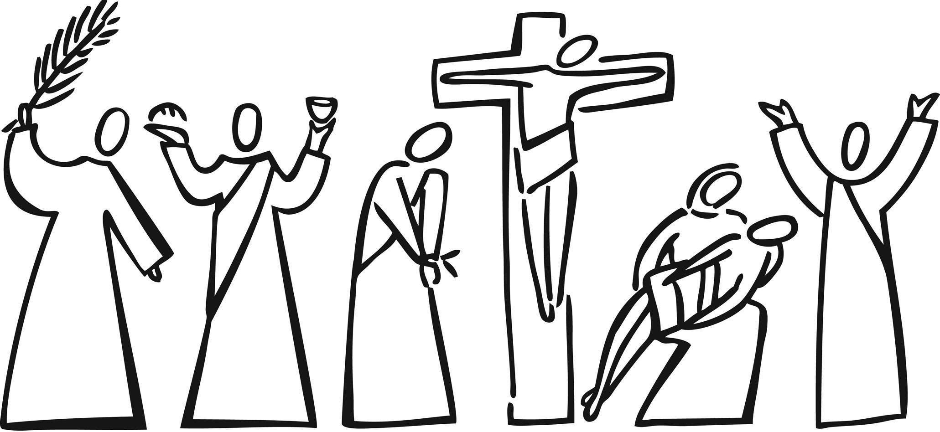
From heav'n you came, helpless babe,
entered our world, your glory veiled;
not to be served but to serve,
and give your life that we might live.

Slide 61
This is our God, the Servant King,
he calls us now to follow him,
to bring our lives as a daily offering
of worship to the Servant King.

Slide 62
There in the garden of tears,
my heavy load he chose to bear;
his heart with sorrow was torn.
‘Yet not my will but yours,’ he said.

Slide 63
This is our God, the Servant King,
he calls us now to follow him,
to bring our lives as a daily offering
of worship to the Servant King.

Slide 64
Come see his hands and his feet,
the scars that speak of sacrifice,
hands that flung stars into space
to cruel nails surrendered.

Slide 65
This is our God, the Servant King,
he calls us now to follow him,
to bring our lives as a daily offering
of worship to the Servant King.

Slide 66
So let us learn how to serve,
and in our lives enthrone him;
each other’s needs to prefer,
for it is Christ we’re serving.

Slide 67
This is our God, the Servant King,
he calls us now to follow him,
to bring our lives as a daily offering
of worship to the Servant King.

Slide 68
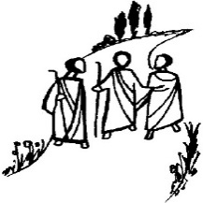
Thanksgivings
Silence is kept
Father of all,
we give you thanks and praise,
that when we were still far off
you met us in your Son
and brought us home.

Slide 69
Thanksgivings
Dying and living,
he declared your love,
gave us grace,
and opened the gate of glory.

Slide 70
Thanksgivings
May we who
share Christ’s body
live his risen life;
we who drink his cup
bring life to others;

Slide 71
Thanksgivings
we whom the Spirit lights
give light to the world.
Keep us firm in the hope
you have set before us,
so we and all your children
shall be free,

Slide 72
Thanksgivings
and the whole earth
live to praise your name;
through Christ our Lord.
Amen.

Slide 73
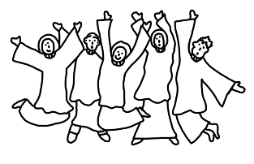
Thanksgivings
Our hymn of celebration
At the name of Jesus
A&M 593 vv 1,3,6

Slide 74
At the name of Jesus
every knee shall bow,
every tongue confess him
King of glory now:
'tis the Father’s pleasure
we should call him Lord,
who from the beginning
was the mighty Word.

Slide 75
Humbled for a season,
to receive a name
from the lips of sinners
unto whom he came,
faithfully he bore it
spotless to the last,
brought it back victorious,
when from death he passed:

Slide 76
In your hearts enthrone him;
there let him subdue
all that is not holy,
all that is not true:
crown him as your Captain
in temptation’s hour;
let his will enfold you
in its light and power.

Slide 77
Blessings & Farewell
We hear this week’s notices
Words of blessing are shared

Slide 78
Blessings & Farewell
Go in the peace of Christ.
Alleluia, alleluia.
Thanks be to God.
Alleluia, alleluia.

