Slide 1

Welcome to our service today
St Barnabas Church 10-May-26

Slide 2

Gathering for Worship
We light our Easter candle

Slide 3

Gathering for Worship
Grace, mercy and peace from God our Father and the Lord Jesus Christ be with you
and also with you.

Slide 4
Gathering for Worship
Almighty God, to whom all hearts are open, all desires known and from whom no secrets are hidden

Slide 5
Gathering for Worship
cleanse the thoughts of our hearts by the inspiration of your Holy Spirit

Slide 6
Gathering for Worship
that we may perfectly love you and worthily magnify your holy name, through Christ our Lord. Amen.

Slide 7
Gathering for Worship
Our opening hymn is
In Christ there is no east or west
A&M 679

Slide 8
1. In Christ there is no east or west,
In him no south or north,
But one great fellowship of love
Thru'out the whole wide Earth.
2. In him shall true hearts ev'rywhere
Their high communion find.
His service is the golden cord
Close binding humankind

Slide 9
3. Join hands, then, children of the faith,
Whate'er your race may be!
Who serves my Father as a child
Is surely kin to me.
4. In Christ now meet both east and west,
In him meet south and north;
All Christlike souls are one in him,
Throughout the whole wide Earth.

Slide 10
Preparing our Hearts
Coming together as God’s family, with confidence let us ask for wholeness from the Lord, for he is full of gentleness and compassion.
A time of silence for reflection

Slide 11
Preparing our Hearts
Almighty God,
our heavenly Father,
we have sinned against you
and against our neighbour
in thought and word and deed,

Slide 12
Preparing our Hearts
through negligence,
through weakness,
through our own deliberate fault.
We are truly sorry
and repent of all our sins.

Slide 13
Preparing our Hearts
For the sake of your Son
Jesus Christ, who died for us,
forgive us all that is past,
and grant that we may serve you
in newness of life to the glory
of your name. Amen

Slide 14
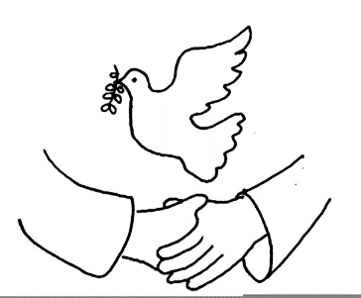
Celebrating God’s Presence
May the Father restore you by his
Spirit and raise you to new life in
Christ our Lord.
Amen.

Slide 15
Celebrating God’s Presence
The Peruvian Gloria
A&M 679

Slide 16
Celebrating God’s Presence
The Collect, the family prayer for the week
Risen Christ, by the lakeside you renewed your call to your disciples: help your Church to obey your command and draw the nations to the fire of your love, to the glory of God the Father.
Amen.

Slide 17
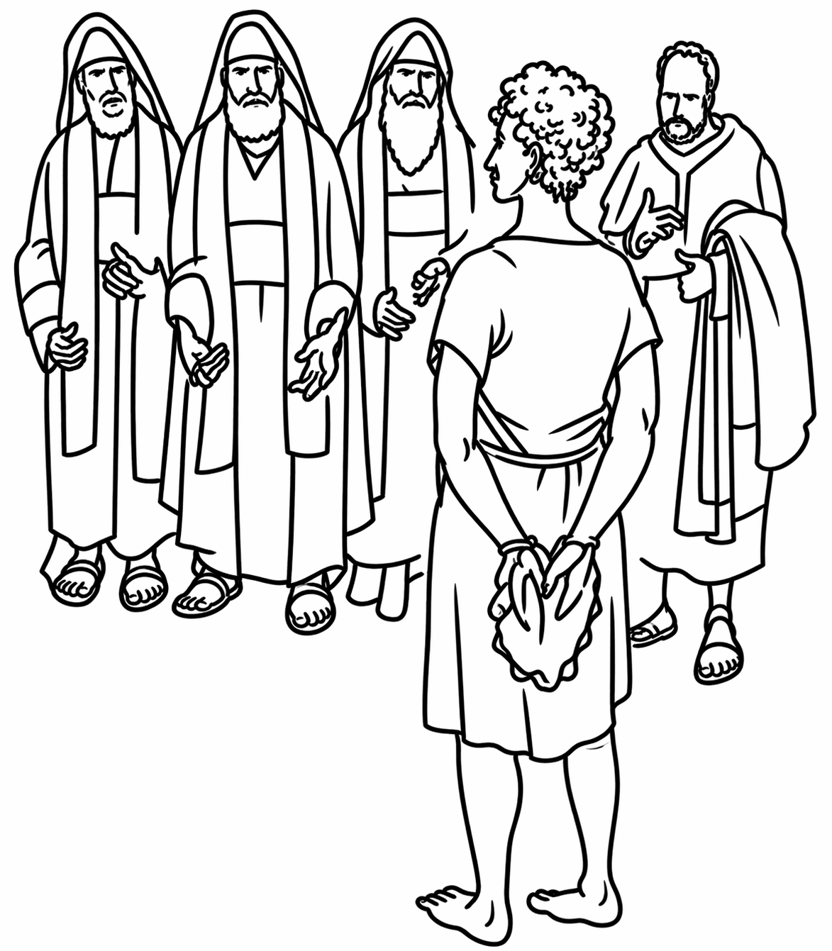
Today’s Readings
Our first reading is
Acts 17:22-31
In which we meet Paul again

Slide 18

Today’s Readings
Hear the Gospel of our Lord Jesus Christ according to John
Glory to you O Lord
John 14:15-21
This is the Gospel of the Lord
Praise to you O Christ

Slide 19
The Easter Threshold
… from SUFFERING to COMMUNITY …

Slide 20

Responding in Faith
Do you believe and trust in God the Father, source of all being and life, the one for whom we exist?
We believe and trust in Him

Slide 21
Responding in Faith
Do you believe and trust in God the Son, who took our human nature, died for us and rose again?
We believe and trust in Him

Slide 22
Responding in Faith
Do you believe and trust in God the Holy Spirit, who gives life to the people of God and makes Christ known in the world?
We believe and trust in Him

Slide 23
Responding in Faith
This is the faith of the Church.
This is our faith.
We believe and trust
in one God, Father, Son
and Holy Spirit. Amen.

Slide 24
Responding in Faith
Today’s Intercessions

Slide 25
Responding in Faith
Christ came and proclaimed the gospel, peace to those who are far off and peace to those who are near.
The peace of the Lord
be always with you
And also with you

Slide 26
Responding in Faith
Our hymn of preparation is
Come down O love divine
A&M 238

Slide 27
1 Come down, O Love divine,
seek thou this soul of mine,
and visit it with thine own ardour glowing;
O Comforter, draw near,
within my heart appear,
and kindle it,
thy holy flame bestowing.

Slide 28
2 O let it freely burn,
till earthly passions turn
to dust and ashes in its heat consuming;
and let thy glorious light
shine ever on my sight,
and clothe me round,
the while my path illuming.

Slide 29
3 Let holy charity
mine outward vesture be,
and lowliness become mine inner clothing:
true lowliness of heart,
which takes the humbler part,
and o'er its own shortcomings
weeps with loathing.

Slide 30
4 And so the yearning strong,
with which the soul will long,
shall far outpass
the power of human telling;
for none can guess its grace,
till he become the place
wherein the Holy Spirit
makes his dwelling.

Slide 31
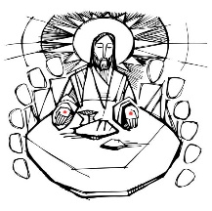
Prayers at the Table
Be present, be present,
Lord Jesus Christ,
our risen high priest;
and make yourself known
in the breaking of bread.
Amen.

Slide 32
Prayers at the Table
The Lord is here
God’s Spirit is with us.
Lift up your hearts.
We lift them to the Lord.
Let us give thanks to the Lord our God.
It is right to give thanks and praise.

Slide 33
Prayers at the Table
It is indeed right, our duty and our joy, always and everywhere to give you thanks, almighty and eternal Father, and in these days of Easter to celebrate with joyful hearts the memory of your wonderful works.

Slide 34
Prayers at the Table
For by the mystery of his passion Jesus Christ, your risen Son, has conquered the powers of death and hell and restored in men and women the image of your glory. He has placed them once more in paradise and opened to them the gates of life eternal.

Slide 35
Prayers at the Table
And so, in the joy of this Passover, earth and heaven resound with gladness, while angels and archangels and the powers of all creation sing for ever the hymn of your glory:

Slide 36
Prayers at the Table
Holy, holy, holy, holy,
Lord of power, Lord of might.
Heav’n and earth
are full of your glory.
Sing hosanna evermore.

Slide 37
Prayers at the Table
Blest and holy, blest and holy
he who comes from God on high.
Raise your voices, sing his glory,
praise his name for evermore.

Slide 38
Prayers at the Table
We praise and bless you, loving Father, through Jesus Christ, our Lord; and as we obey his command, send your Holy Spirit, that broken bread and wine outpoured may be for us the body and blood of your dear Son.

Slide 39
Prayers at the Table
On the night before he died he had supper with his friends and, taking bread, he praised you. He broke the bread, gave it to them and said: Take, eat; this is my body which is given for you; do this in remembrance of me.

Slide 40
Prayers at the Table
When supper was ended he took the cup of wine. Again he praised you, gave it to them and said: Drink this, all of you; this is my blood of the new covenant, which is shed for you and for many for the forgiveness of sins. Do this, as often as you drink it,
in remembrance of me.

Slide 41
Prayers at the Table
So, Father, we remember all that Jesus did, in him we plead with confidence his sacrifice made once for all upon the cross. Bringing before you the bread of life and cup of salvation, we proclaim his death and resurrection until he comes in glory.

Slide 42
Prayers at the Table
Jesus Christ is Lord!
Lord, by your cross and resurrection you have set us free.
You are the Saviour of the World.

Slide 43
Prayers at the Table
Lord of all life, help us to work together for that day when your kingdom comes and justice and mercy will be seen in all the earth. Look with favour on your people, gather us in your loving arms and bring us with all the saints to feast at your table
in heaven.

Slide 44
Prayers at the Table
Through Christ, and with Christ, and in Christ, in the unity of the Holy Spirit, all honour and glory are yours, O loving Father, for ever and ever.
Amen!

Slide 45
Prayers at the Table
We say the Lord’s Prayer together and then we pray
We break the bread of life,
and that life is the light of the world.
God here among us,
light in the midst of us,
bring us to light and life.

Slide 46
Prayers at the Table
This is Christ’s table.
He welcomes all. Come and be fed.
Voices old and new,
Lives young and old.
This is who we are.
This is who we are becoming.
Amen! Together we come!

Slide 47
Thanksgivings
Communion is shared and we sing
A&M 274
Father we adore you,
Lay our lives before you.
How we love you!

Slide 48
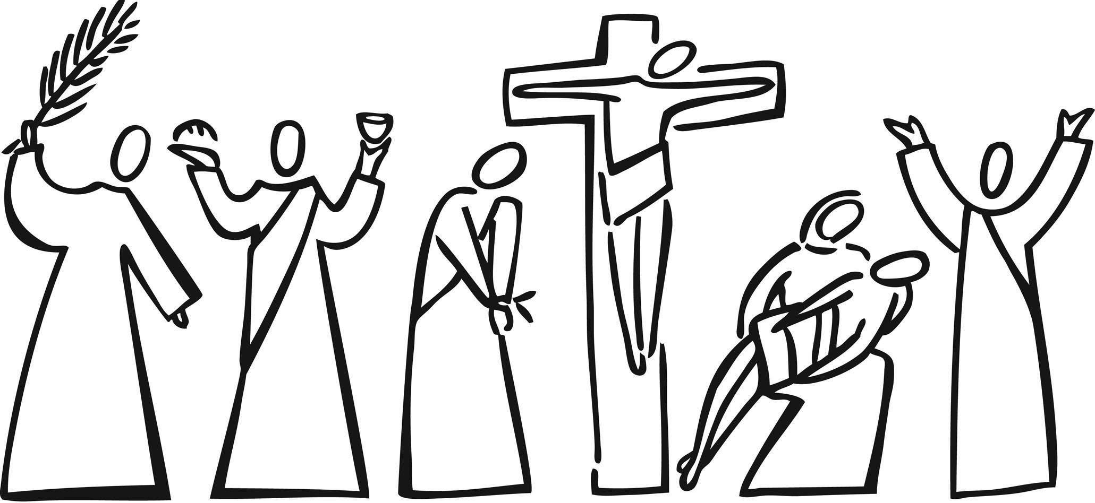
Jesus we adore you,
Lay our lives before you.
How we love you!
Spirit we adore you,
Lay our lives before you.
How we love you!

Slide 49
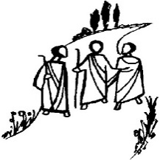
Thanksgivings
Silence is kept
Father of all,
we give you thanks and praise,
that when we were still far off
you met us in your Son
and brought us home.

Slide 50
Thanksgivings
Dying and living,
he declared your love,
gave us grace,
and opened the gate of glory.

Slide 51
Thanksgivings
May we who
share Christ’s body
live his risen life;
we who drink his cup
bring life to others;

Slide 52
Thanksgivings
we whom the Spirit lights
give light to the world.
Keep us firm in the hope
you have set before us,
so we and all your children
shall be free,

Slide 53
Thanksgivings
and the whole earth
live to praise your name;
through Christ our Lord.
Amen.

Slide 54
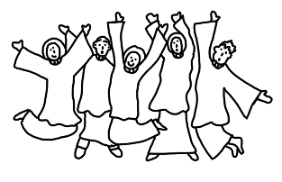
Thanksgivings
Our hymn of celebration
The Spirit lives to see us free
A&M 264

Slide 55
The Spirit lives to set us free,
walk, walk in the light;
He binds us all in unity,
walk, walk in the light.
Walk in the light,
Walk in the light,
Walk in the light,
Walk in the light of the Lord.

Slide 56
Jesus promised life to all,
walk, walk in the light;
the dead were wakened by His call,
walk, walk in the light.
Walk in the light,
Walk in the light,
Walk in the light,
Walk in the light of the Lord.

Slide 57
He died in pain on Calvary ,
walk, walk in the light;
to save the lost like you and me,
walk, walk in the light.
Walk in the light,
Walk in the light,
Walk in the light,
Walk in the light of the Lord.

Slide 58
We know His death was not the end,
walk, walk in the light;
He gave His Spirit to be our friend,
walk, walk in the light.
Walk in the light,
Walk in the light,
Walk in the light,
Walk in the light of the Lord.

Slide 59
By Jesus’ love our wounds are healed,
walk, walk in the light;
the Father’s kindness is revealed,
walk, walk in the light.
Walk in the light,
Walk in the light,
Walk in the light,
Walk in the light of the Lord.

Slide 60
The Spirit lives in you and me,
walk, walk in the light;
His light will shine for all to see,
walk, walk in the light.
Walk in the light,
Walk in the light,
Walk in the light,
Walk in the light of the Lord.

Slide 61
Blessings & Farewell
We hear this week’s notices
Words of blessing are shared

Slide 62
Blessings & Farewell
Go in the peace of Christ.
Alleluia, alleluia.
Thanks be to God.
Alleluia, alleluia.

